Slide 1
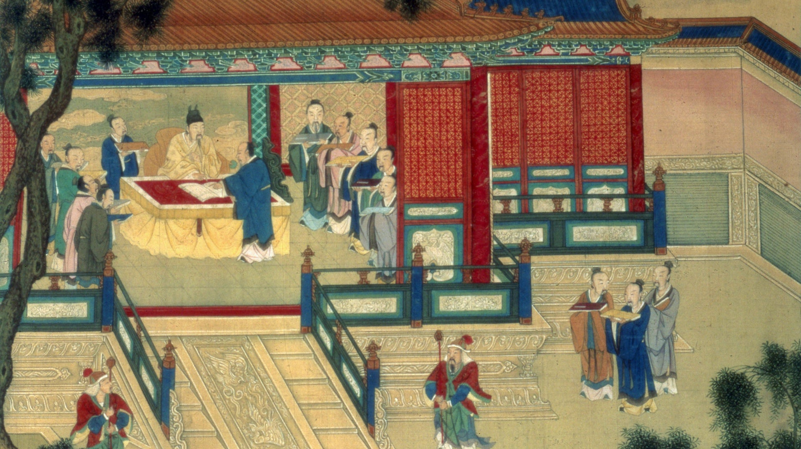
Aim: How did the Han Dynasty continue to build a unique culture for Chinese prosperity?
Do Now: What philosophy was employed by Emperor Qin Shi Huang Di?
How might this allow the new Han Dynasty to claim the Mandate of Heaven?
Announcements: Multiple Choice Exam Monday 11/4

Slide 2
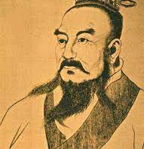
The Han Dynasty (206 BCE-220 CE)
Commoner Liu Bang gathered his fellow men under the rally cry that the harsh Legalist ruling of the Qin was against the Mandate of Heaven.
The Han expanded the size of the Chinese empire as they conquered modern day Mongolia, Vietnam and the northern half of the Korean Peninsula.
Han emperors established imperial schools which educated and tested court officials and was used to staff positions in the bureaucracy.
The Han dynasty is considered a golden age for Chinese philosophy, government, culture and inventions as it was a time of relative peace and political prosperity

Slide 3
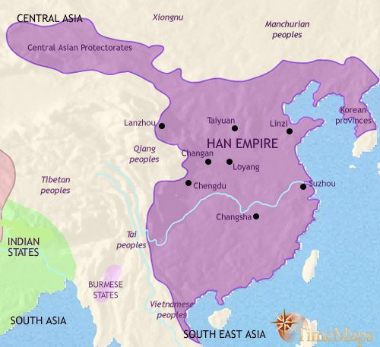

Slide 4
Independent Writing
Read slides 4-11,
Construct a short paragraph in your notebook and answer the following prompt:
Assess the different ways in which the Han Dynasty attempted to implement structure and stability during their rule of China. About 7-9 sentences!

Slide 5
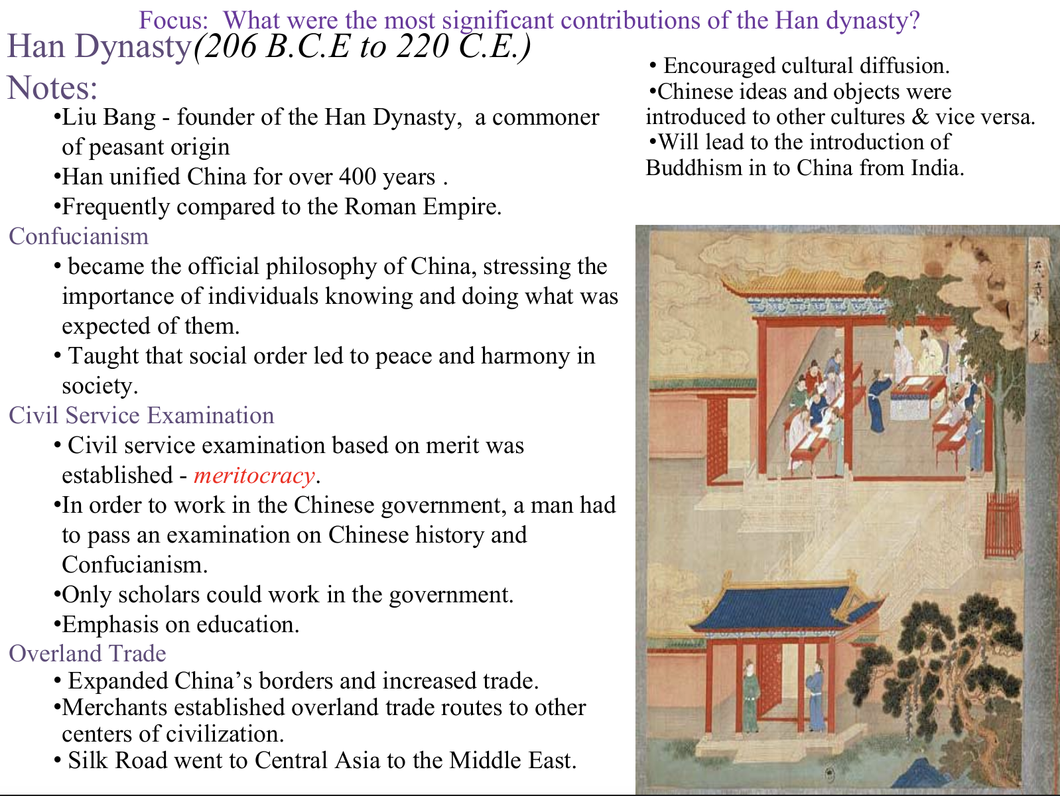

Slide 6
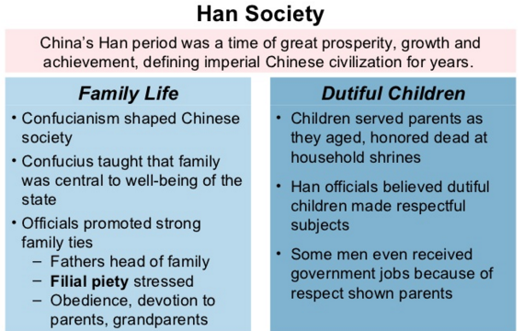
Focus: How did China’s unique Confucian values influence social views?

Slide 7
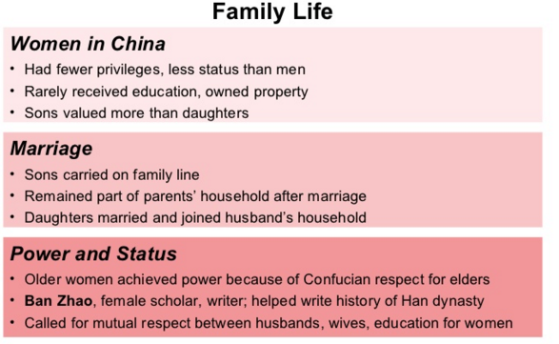
Focus: How did China’s unique Confucian values influence social views?
rarely

Slide 8
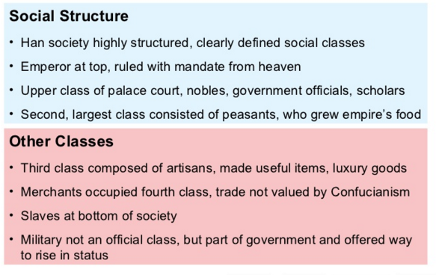
Focus: How did China’s unique Confucian values influence social views?
Why did merchants hold a lower status in Chinese society? How does this view coincide with Confucian values?

Slide 9
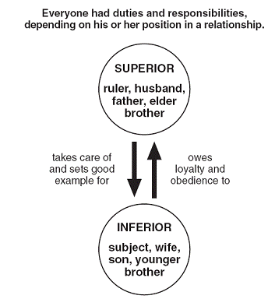
Focus: How did China’s unique Confucian values influence social views?

Slide 10
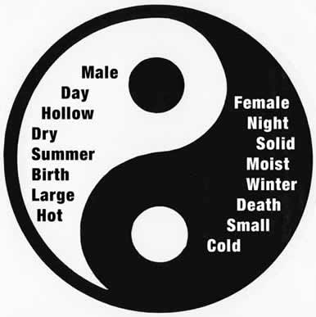
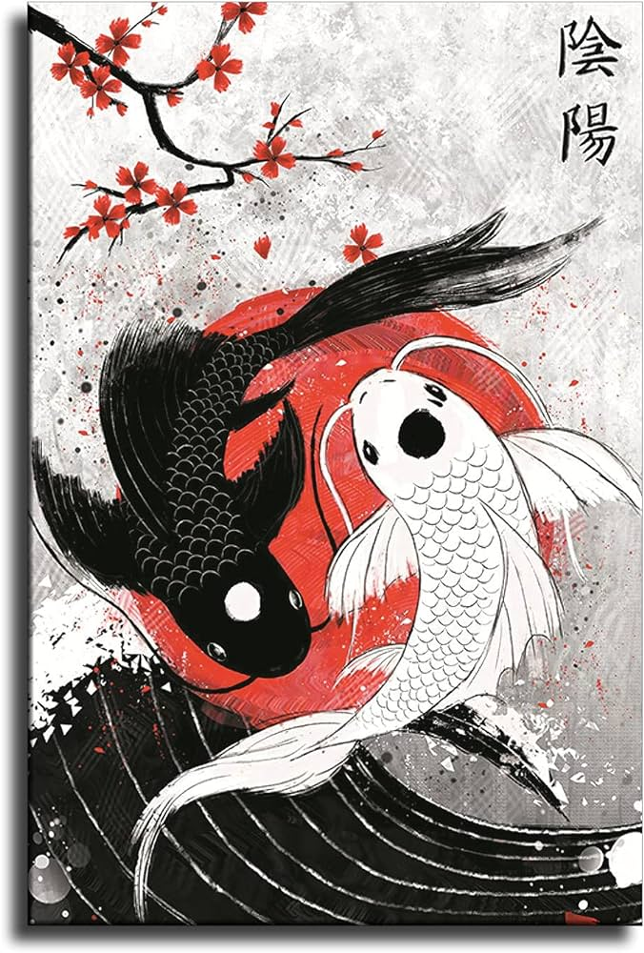
Yin and Yang
Focus: How did China’s unique Confucian values influence social views?
The Daoist conception of Yin and Yang, or nature’s balance of opposing forces, also played a large role in Han society. One of the biggest reflections was in gender roles. Read the next two slides to learn more!

Slide 11
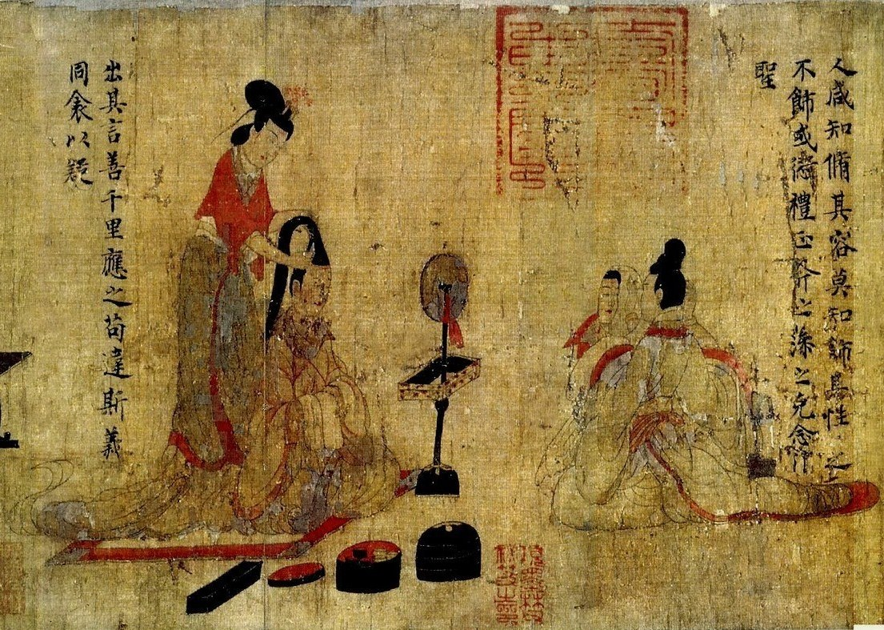
The Admonitions of Women Ban Zhao (45 CE-116 CE) was an educated aristocratic woman of the later (Eastern) Han dynasty.
Focus: How did China’s unique Confucian values influence social views?
The following excerpts are taken from Ban Zhao’s corpus (collection of written texts) of writing, from her courtly life.
In a very Daoist manner Ban Zhao was a paradox. An educated female Confucian scholar in the Han Dynasty. Read the next slide to see how her worldview both aligned with and challenged traditional Confucianism.
Admonitions: authoritative counsel or warning

Slide 12
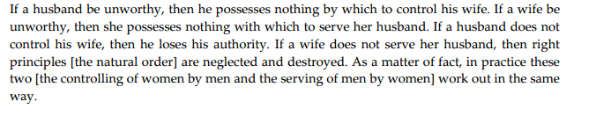
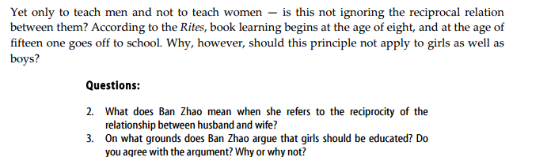
Husband and Wife
Focus: How did China’s unique Confucian values influence social views?

